Slide 1
MOBIKWIK
Online mobile recharge
By:- Radhika yadav

Slide 2
Problem Statement
Online Mobile Recharge is an application developed to recharge mobile phones. The project focuses at providing an easy and reliable platform to recharge mobile of any telecommunication company through online without buying recharge card. The registered users of the system can recharge their prepaid mobile phones from anywhere at any time.

Slide 3
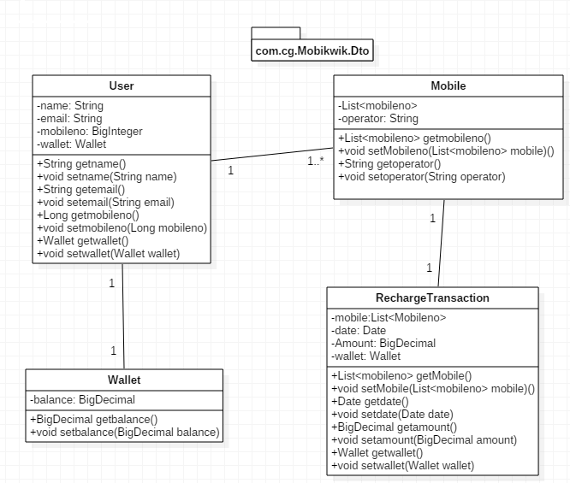
POJO Class:-

Slide 4
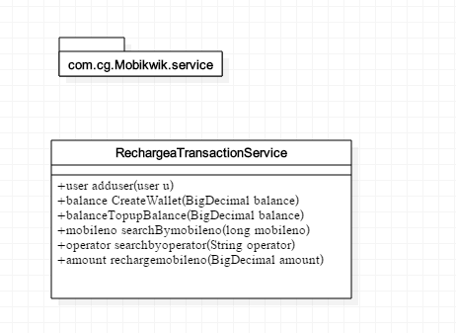
Service Interface:-

Slide 5
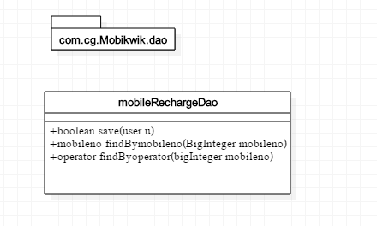
Repository Interface:-

Slide 6
Thank you

